Slide 1
ELEMENTS OF ART: SPACE, COLOR, SHAPE, FORM, TEXTURE, LINE & VALUE
VALUE

Slide 2

VALUE IS…
ELEMENT OF ART THAT REFERS TO THE LIGHTNESS OR DARKNESS OF A COLOR

Slide 3
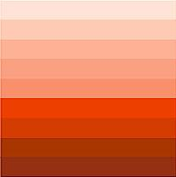
TINT
COLOR + WHITE = TINT
COLOR + WHITE = LIGHT
TINTS ARE LIGHT

Slide 4

SHADE
COLOR + BLACK = SHADE
COLOR + BLACK = DARKNESS
SHADES ARE DARK

Slide 5
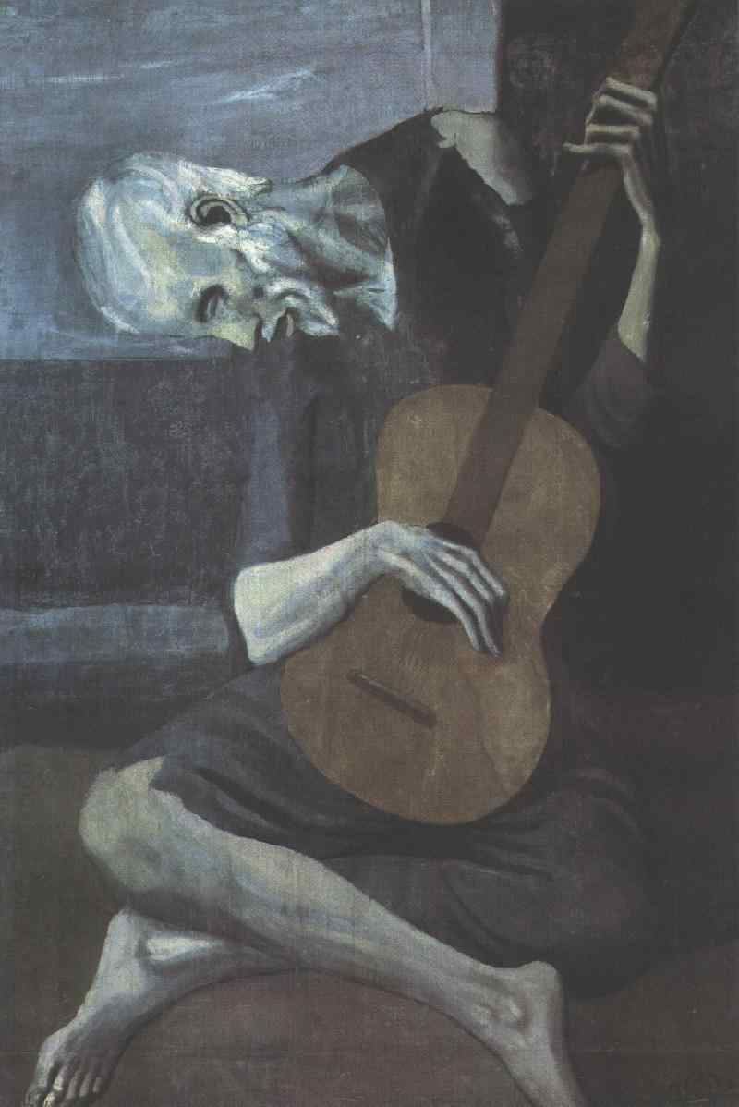
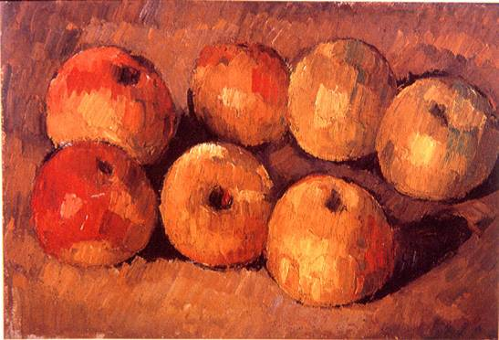

Slide 6
